Slide 1


Trust. Built on Science
Manufacturing a more sustainable future.
Reducing business risk.
A presentation by [member] on behalf of the
Leather & Hide Council of America
DATE

Slide 2
How accurate is your data on the impacts on the planet of the materials you use? How do you report that? And what brand and financial risks is your material choice is creating?
The US leather industry has funded the first market-specific, independent open-source Life Cycle Assessment for its materials.
We think you will find the results interesting and of commercial value.

Slide 3

What is a Life Cycle Assessment?
A Life Cycle Assessment (LCA) is a process for calculating the lifetime environmental impact of a product or service in terms of a standard unit of measure (Functional Unit), for example, a square metre of leather.
It enables Environmental, Social and Governance improvements through the selection of best materials, identification and addressing of impact hotspots, benchmarking, labelling and marketing.
L&HCA has set out to give definitive data for industry customers to use in materials selection, sourcing and communication.
The ISO sets guidelines for LCA, including under ISO 14040 and 14044. The LCA forms part of the US-led Industry Sustainability Program.

Slide 4
Why enhanced ESG data can build your brand & improve business performance

Slide 5

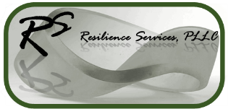
Building confidence through best practice
The Leather & Hide Council of America, of which we are a member, champions the sustainability of leather as a durable, slow-cycle, material and its use as a way of repurposing waste.
The LCA commissioned Resilience Services PLLC to independently evaluate US leather with tannery data and analysis provided by Spin360.
The LCA conforms to ISO 14040/14044 standards, covers from field to tannery gate and, uniquely, the impact of different animal husbandry practices using data sourced from an Integrated Farm System Model developed in partnership with USDA Agricultural Research Service.
Recognising geographic differences in data and industry requirements, it covers both economic value and mass-based calculation with functional units of one kilogram for hides and by one square meter for leather.

Slide 6
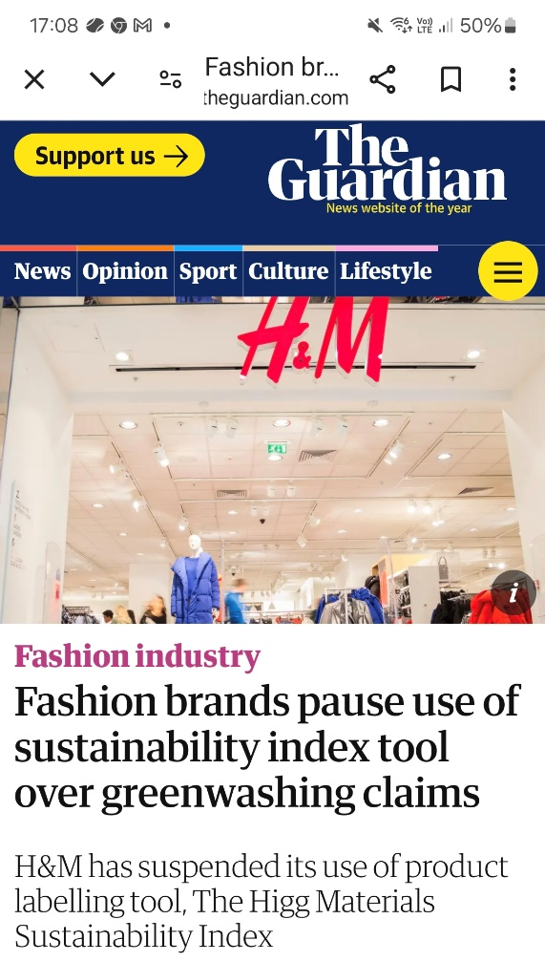
Delivering credible, market specific, reporting data
When selecting materials, from wool and cotton to leather or plastic, there are few sources for credible ESG data.
For fashion, the Higg Index has, after users were taken to court for greenwashing, rebranded as Worldly. It continues to offer limited information on data sources, timeliness and modelling.
The US LCA delivers a comprehensive and transparent evaluation with ongoing investment in data and analysis.

Slide 7
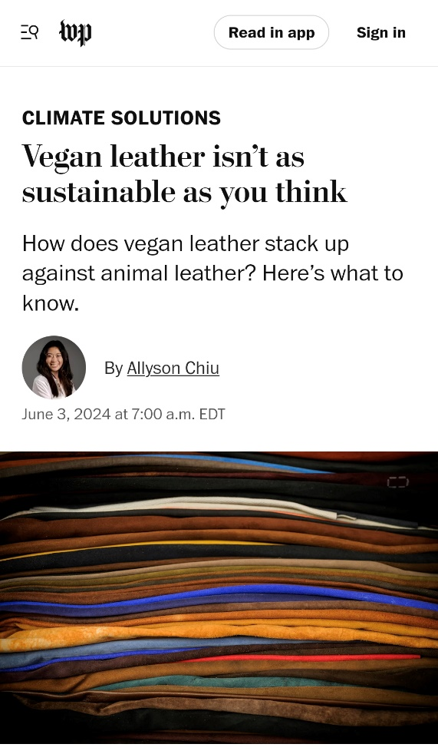
The tools to choose a reduced carbon footprint
The promotion of synthetics and plastic-based compounds because they are low cost, or “environmentally friendly”, creates increased carbon and environmental impact.
L&HCA’s LCA shows that the environmental impact of US leather has been hugely overstated. And as with all LCAs it does not account for the environmental benefits of cattle grazing or keeping hides out of landfill.
Whether engaged in ESG reporting, providing carbon related export data or targeting a zero-carbon future, poor data skew investment in environmental efficiency, reduce competitiveness and can even incentivize bad behaviour.
And it is costing the planet.

Slide 8
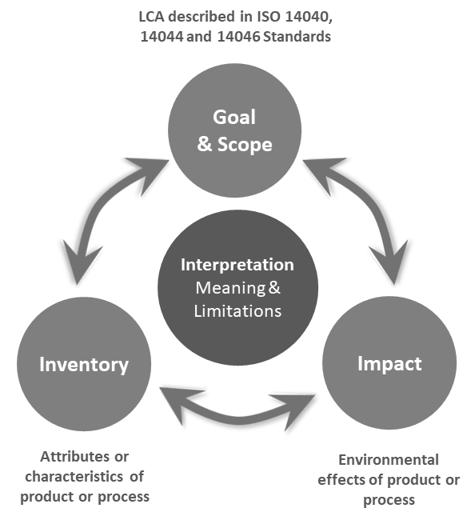
LCA & sustainability: Manage what you measure
What?
LCA is a multi-step procedure for calculating the lifetime environmental impact of a product or service in terms of a standardized unit of measure, the functional unit (FU).
Why?
Product development / improvement
Selection of best materials or process options (e.g., conservation)
Identification of ‘hotspots’ for innovation
Benchmarking
Product labels / marketing
Strategic planning
Inform public policy
Notes:
Why are we doing the study?
What are the system characteristics – what is used
What are the impacts associated with each phase (multi faceted)
Interpretation of the results into understanding of system in support of action to improve it

Slide 9
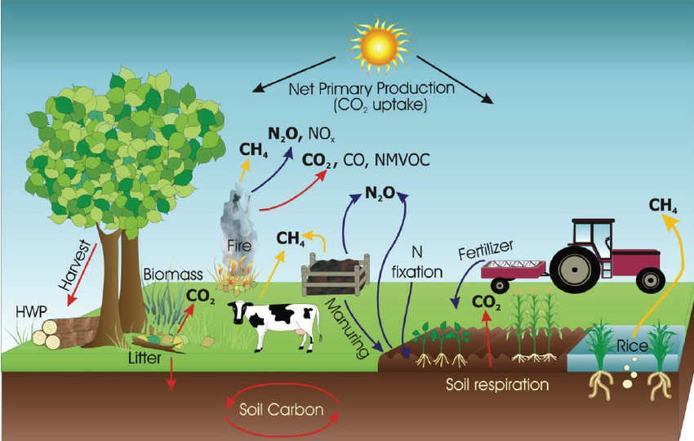
Life cycle inventory?
Full accounting of material and energy flows through the system at unit process level.
Often reliant on biogeochemical modeling or other process models.
e.g., NPK (nitrogen, phosphorus, and potassium) inputs and NPK losses, including emissions, with respect to yields.

Slide 10
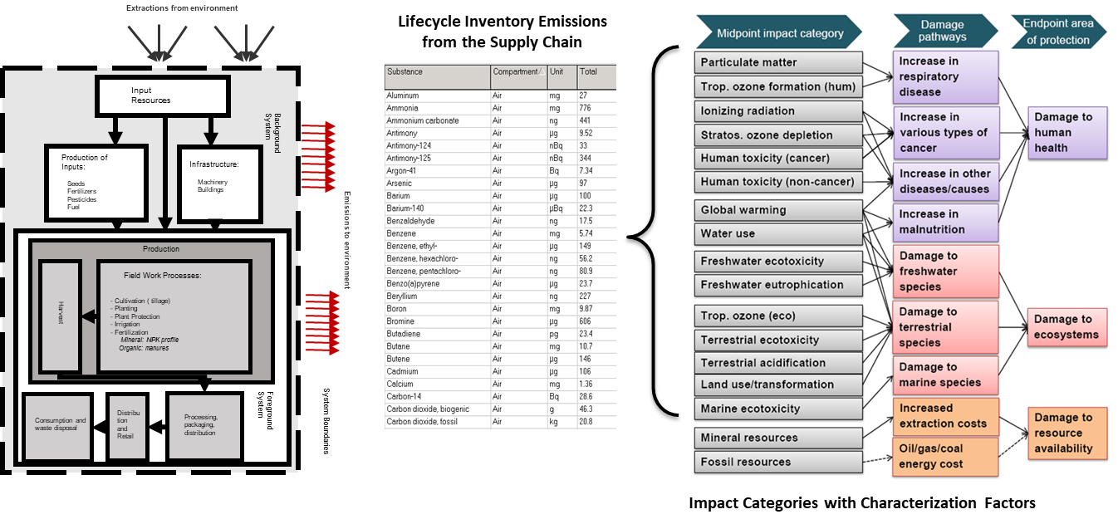
Life Cycle Impact Assessment (LCIA)
Midpoint and endpoint categories in the ReCiPe impact assessment framework. Arrows represent causal pathways; inputs to midpoint categories are the lifecycle inventory. (Verones et al., 2020)

Slide 11
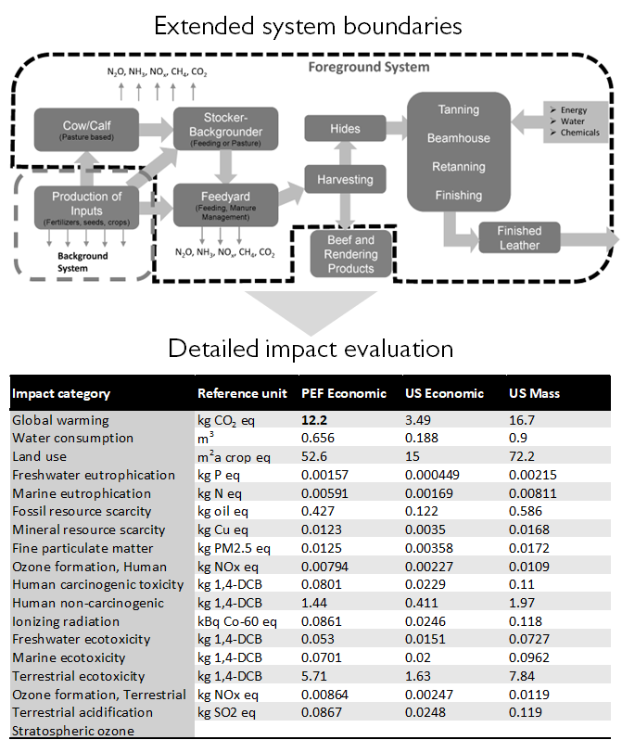
Addressing issues of importance
The L&HCA LCA looks from field to tannery gate.
It covers a range of environmental impact categories, including Global Warming Potential, fossil fuel usage, water and other impacts from biodiversity to soil health, marginal land use, fire management, nutrition and socio-economic factors.
This detail allows the supply chain to conduct a more complete review of sourcing and production and integration of related ESG data.
The report is available for free and is built on open-source data, transparent methodology and is under review for ISO conformity assessment.

Slide 12
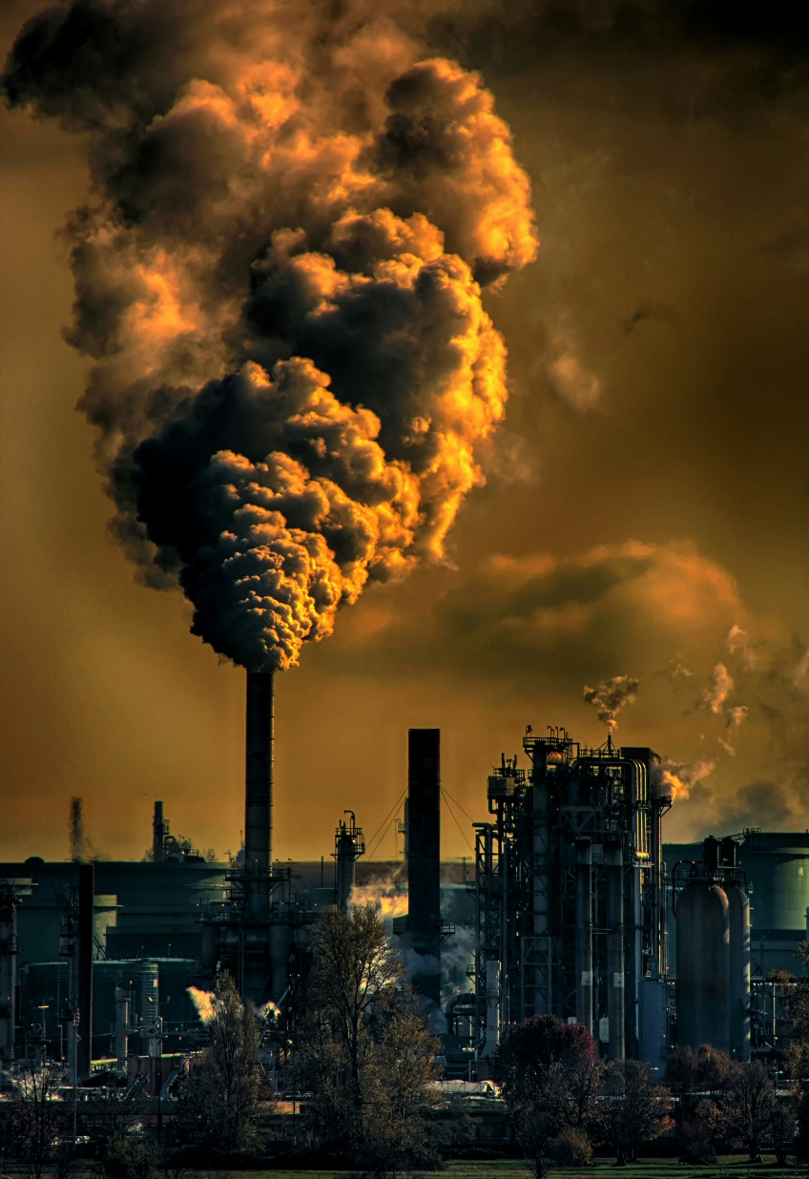
Prioritizing investment, reducing commercial risk
Taking a full life cycle approach, leather has been assessed from the field to harvest, from tanning to finishing.
Tracking back to the field highlights a recognized analytical gap in synthetics, which do not include the impact of oil exploration, extraction and, often, production.
This creates significant risk, from retooling production lines to full ESG accounting and is recognized as one of the factors that incentivizes the use of plastics over leather.
As the L&HCA better understands why and how leather use is good for the planet, it will answer questions, what are the impact benefits of using leather, how long does leather last compared to alternatives, and what this means for its impact profile.
Photo by Chris LeBoutillier

Slide 13
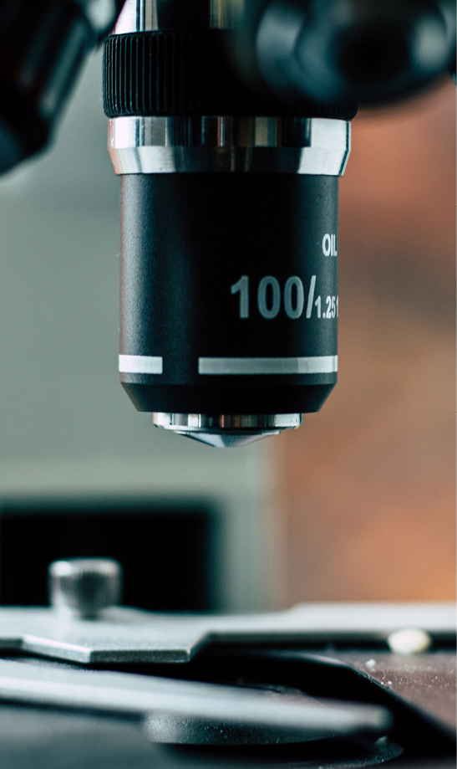
Integrating into ESG reporting
Peer reviewed for ISO conformance, the LCA can inform your ESG systems, reducing long term risk and delivering immediate improvements in your costs and production practices.
This enables factual reporting, quantification and reduction of product’s carbon emissions profile.
For users going further, it can help the implementation of best practice, leading to a reduction in the level of plastic use benefitting the environment, and fossil fuels and their impact on the climate.
So, what do the findings mean for you?

Slide 14
US hide and leather performs exceptionally in ESG terms.
It is significantly more sustainable than previously understood.

Slide 15
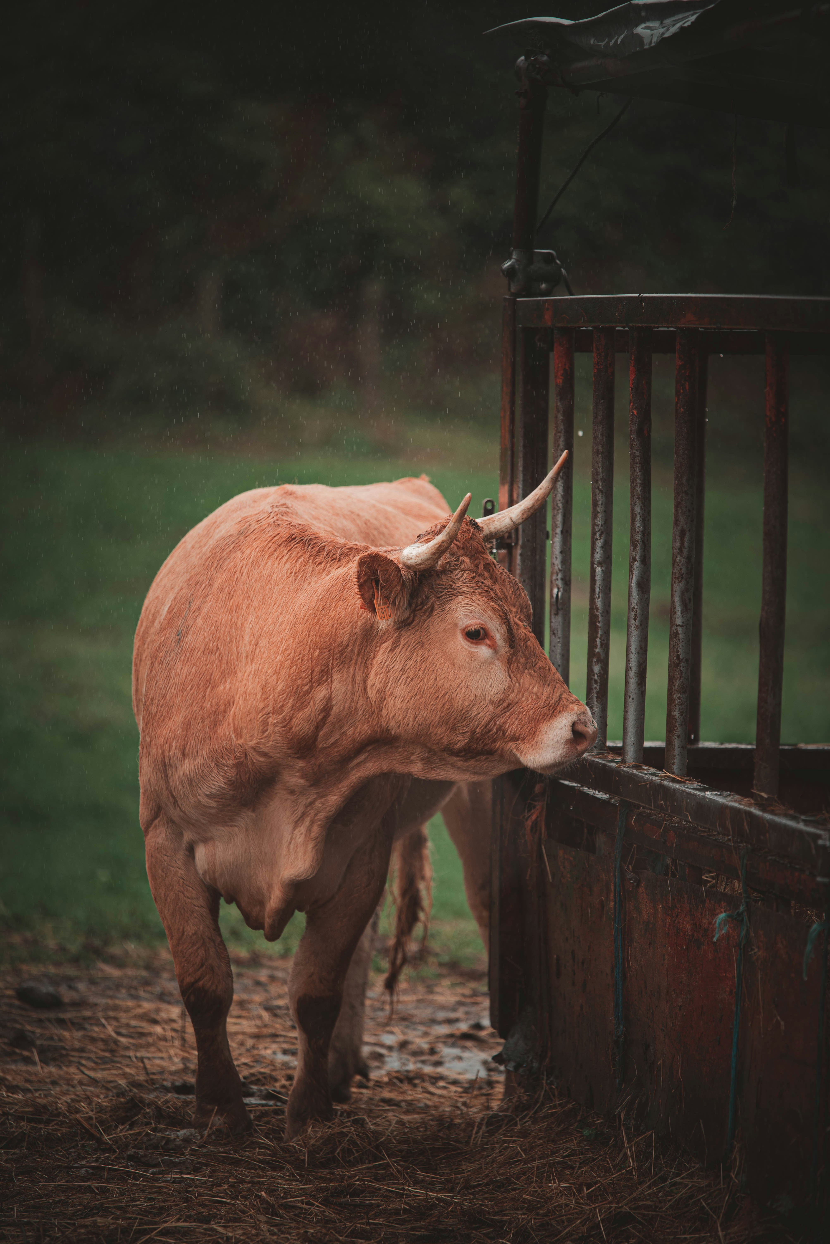
Context and Data
Full data can be found in the report. In addition, there is continuing research looking at different geographies, and research how leather’s relative durability reduces carbon cost over time.
Key findings of first phase data are presented over the following pages. We can arrange a meeting to discuss further with the research team or take additional questions for response.
Notes:
Modelling of multi-function outputs is critical for systems such as leather. Hide allocation values vary by a factor of five. Economic allocation is a last resort, per ISO guidelines. Allocations for hide are indicated as below.
Photo by Juan Manuel Sanchez on Unsplash

Slide 16
Field to Hide: Average hide figures and units - US
Allocation depending on methodology.

Slide 17
Animal Husbandry Impacts: Average - US
Rational selection of allocations can eliminate the misinformation inherent in the some hide data. Using better data can impact actual impact categories, reducing CO2e emission allocation by 70% or more.
[A US economic average has been used for headline presentation.]

Slide 18
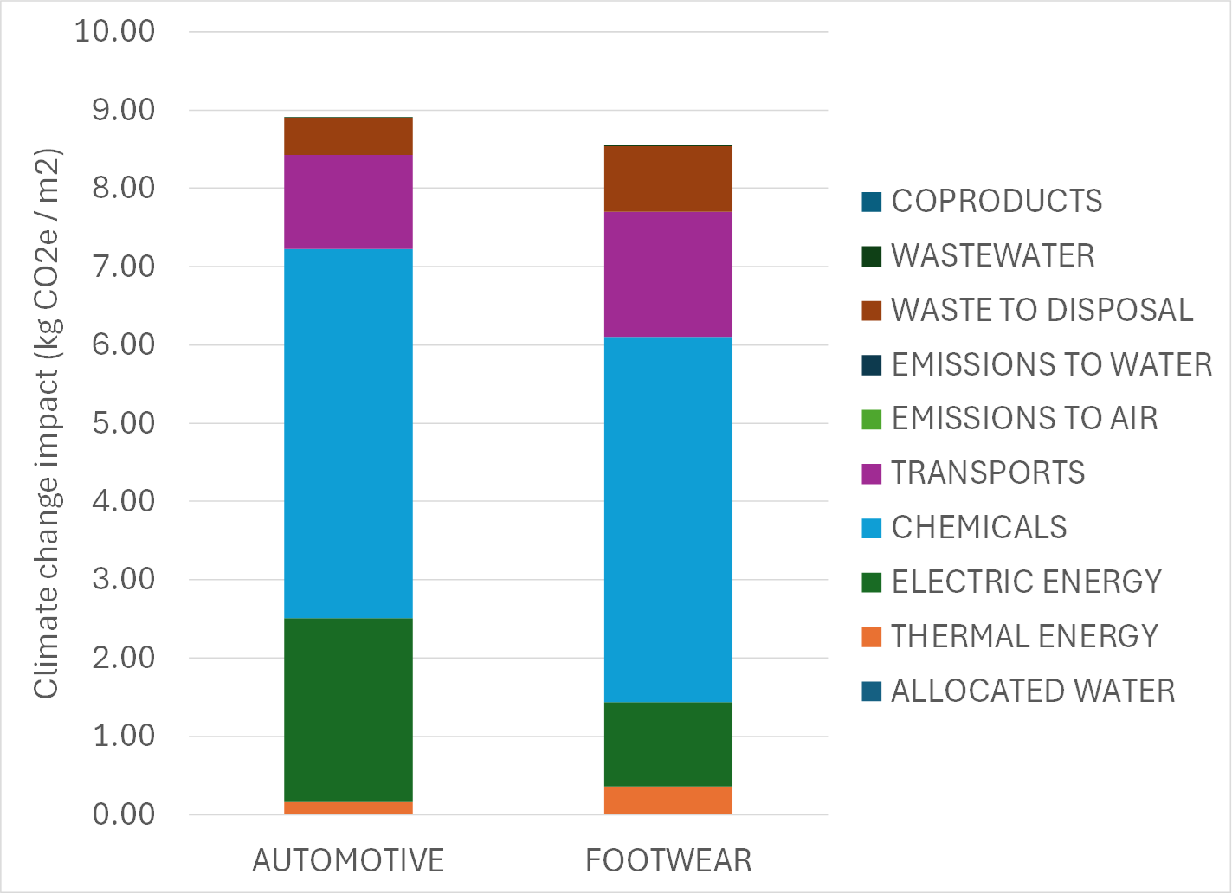
Tanning Impacts: Leather average - global
The following analysis is for the use of US hides for leather used in automotive and footwear. The functional unit for leather is one square meter.

Slide 19
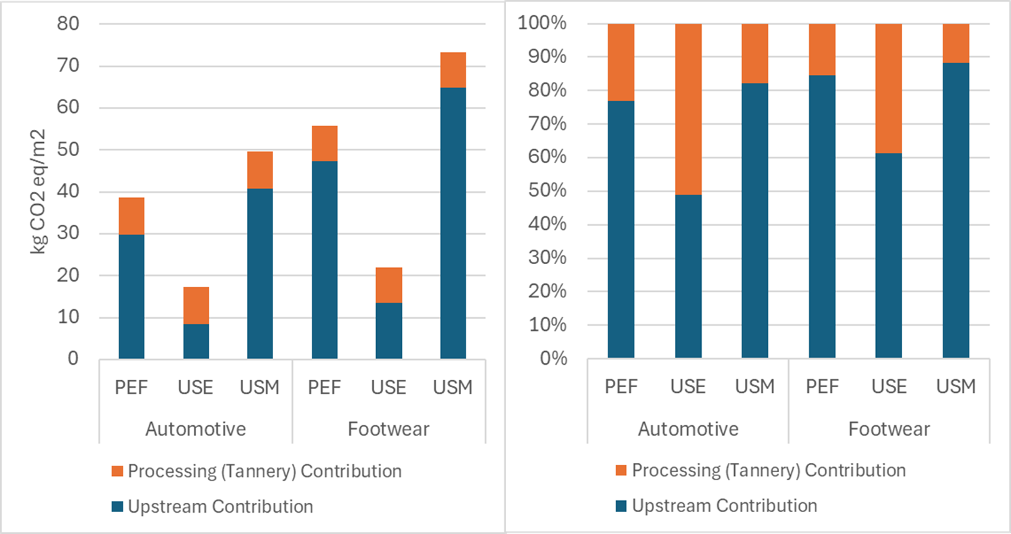
Impact by stage: The importance of sourcing
As reflected in the charts below, hides can reflect more than 50% of the environmental impact of leather production. Using appropriate allocation factors and transparent data and methodologies is critical when evaluating and sourcing materials.

Slide 20
What it means for
[client name]

Slide 21
Insert Logo Here
Better insight, targeted investment and a reduced carbon footprint
Current leather usage 2023:
XXXXX sqm
Higg Index Carbon Estimate:
XXXX tonnes CO2e
LCA US leather estimate:
XXXX tonnes CO2e
Total estimated change:
XXXX tonnes CO2e / XX%
Using the new LCA data - robust, rigorous, transparent and up-to-date, we can provide an initial estimate based on 2023 sales of the change in the key CO2e emissions metric.
With the evaluation used we can identify immediate gains driven by animal husbandry sourcing where significant variance is identified.
Supplementary data is available on all key metrics based on a US average or aligned by husbandry type.

Slide 22
Thank You
CTA
Membership
LCA With LRL

